Slide 1
Customized Lexical Analyzer
Sourav Paul (RA2011003010016)
Suraj Pratap Singh (RA2011003010031)

Slide 2
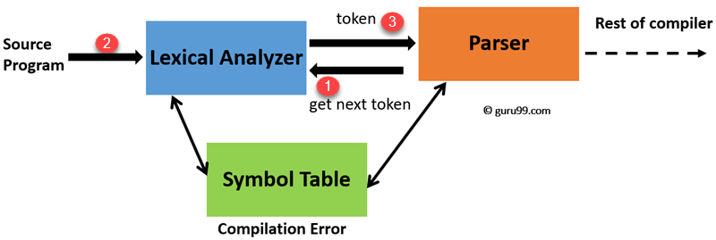
Introduction
Hello everyone, in this presentation, we will be discussing the Lexical Analyzer. A lexical analyzer is a crucial part of the compiler, and it reads the source code and identifies the tokens in it.

Slide 3
Lexical Analysis Process
Input Buffering
Tokenization
Lexeme Classification
The lexical analysis process can be divided into three stages:
Input Buffering
Tokenization
and Lexeme Classification
Let's take a closer look at each of these stages.

Slide 4
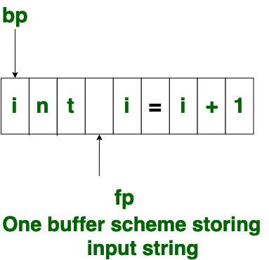
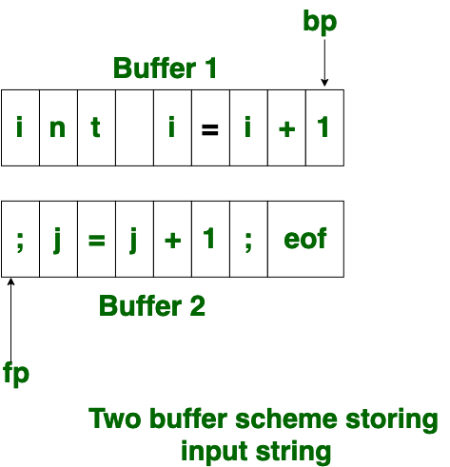
Input Buffering
Input Buffering is the process of reading a block of characters from the input source and storing them in a buffer. This buffer is then used by the lexical analyzer to process the characters and identify the tokens. Input buffering is essential because it allows the lexical analyzer to read ahead and look for patterns in the input.
Buffering
One Buffer Scheme
Two Buffer Scheme

Slide 5
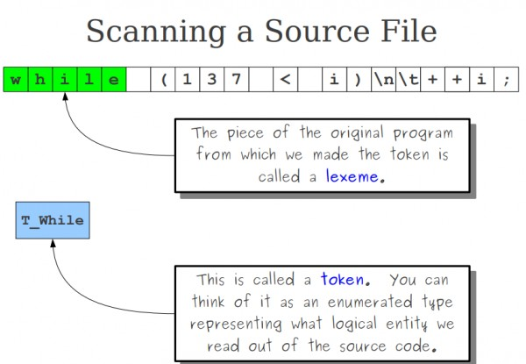
Tokenization
Tokenization is the process of dividing the input into meaningful units called tokens. Tokens can be anything from keywords, identifiers, operators, and literals. The lexical analyzer reads the input from the buffer and divides it into a sequence of tokens. The tokens are then passed on to the next stage of the compilation process.

Slide 6
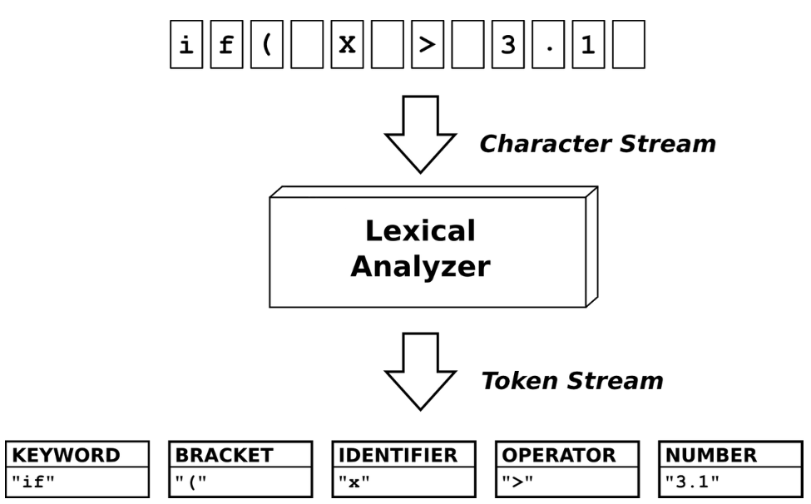
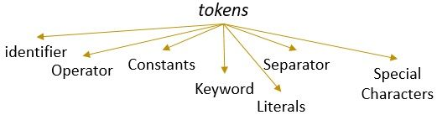
Lexeme Classification
Lexeme Classification is the process of assigning a token category to each token. The categories are defined by the language specification and include reserved words, identifiers, operators, and literals. The lexical analyzer identifies the token category for each token and assigns it a specific code.

Slide 7
Assumptions for our language
Special Symbol: ; { } ( ) , #
Keyword: number , character , floating , Boolean , console_in , console_out , automatic , doub , structure , breaker , els , longer , option , socket , option , enumeration , reg , type , external , send , combine , flow , loop , sign , empty , does , if , stat , until , fixed , go , size , vol , const , mini , unsign
Pre-processor Directives: import , define
Library: inputoutput , studinp_out , string
Operators: *, +, >>, <,>
Numbers/Integers: All numbers Values from 0-9.
Identifier/ Variables: All alphabetic strings except the keywords, numbers , Pre-processor directive and library strings.

Slide 8
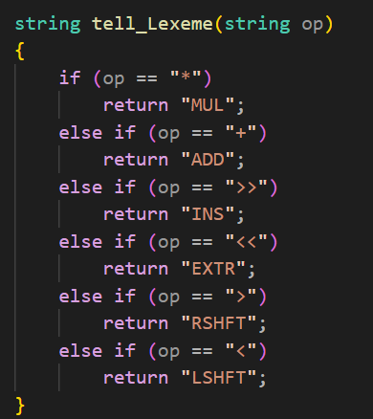
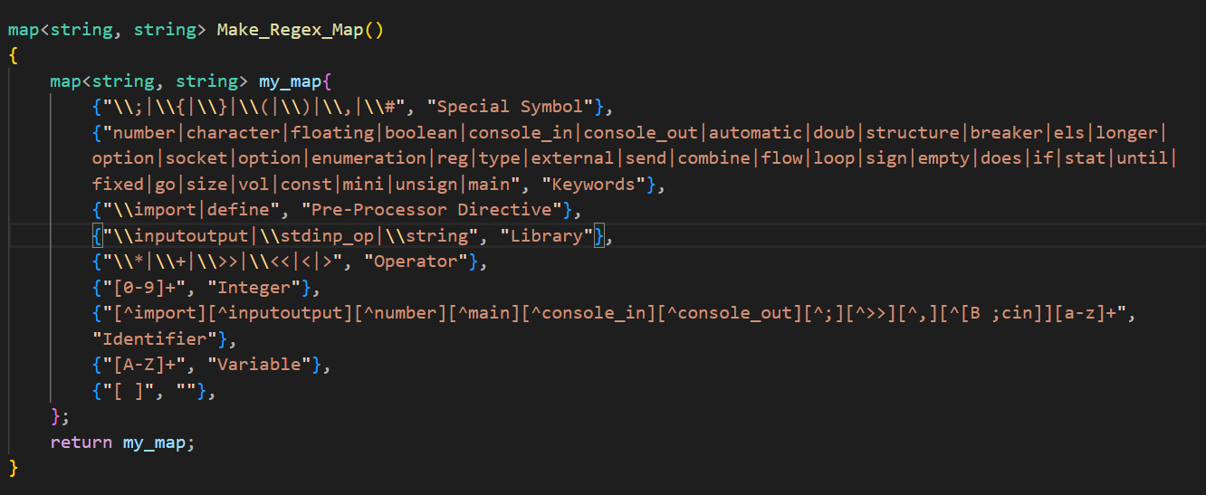
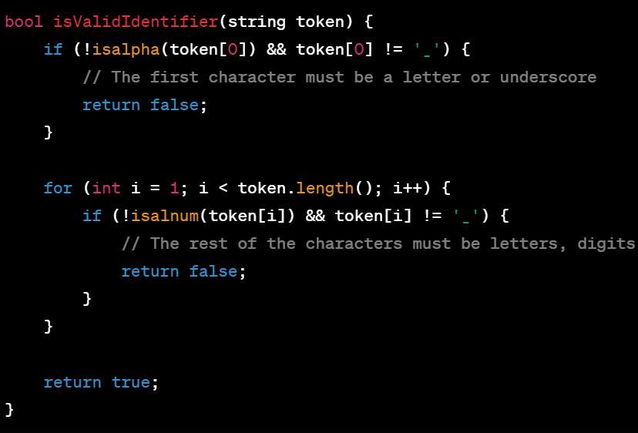
Code snippets

Slide 9
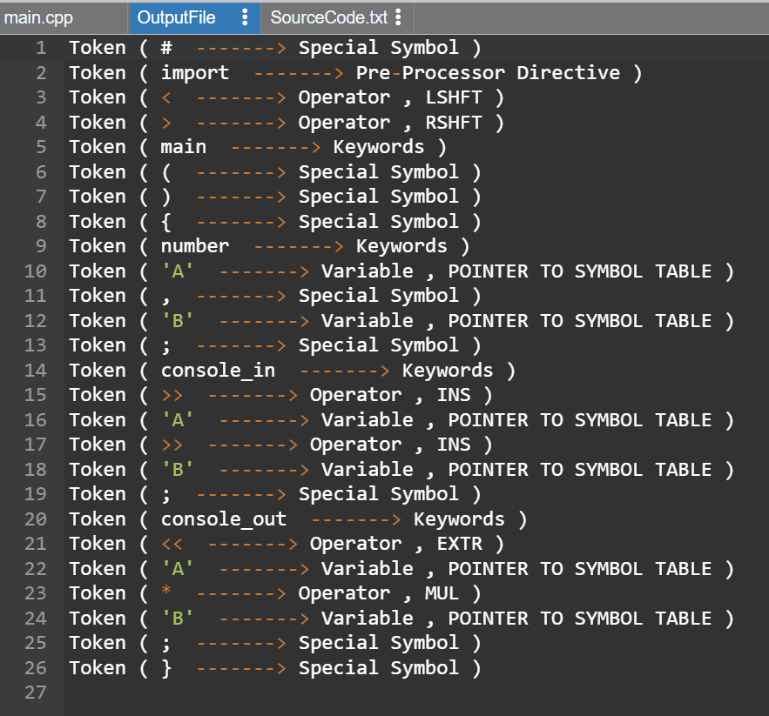
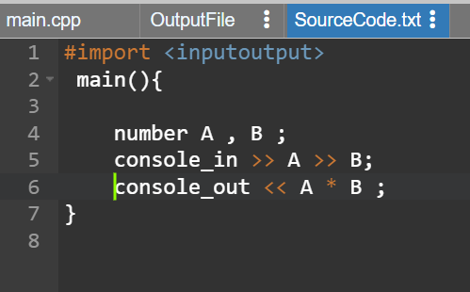

Input file
output file

Slide 10
Conclusion
In this presentation, we have discussed the importance of the Lexical Analyzer and its role in the compilation process. The Lexical Analysis process includes input buffering, tokenization, and lexeme classification, which is used to break down the source code into meaningful units.
By correctly identifying tokens in the source code, the lexical analyzer can produce an output that can be used by other parts of the compiler. Therefore, understanding the lexical analysis process is crucial for creating a robust and efficient compiler.

